Slide 1

Modeling and Simulation of a Martian Rover
Submitted by: Sandip Sharan Senthil Kumar (119340196)
Jayasuriya Suresh (118509426 )
Institute : University of Maryland-College Park
Course : ENPM – 662 Introduction of Robot Modeling(Project -2)

Slide 2
Table of contents
Introduction
Motivation
Steps Involved
Denavit–Hartenberg Frames and Table
Forward Kinematics Calculation
Inverse Kinematics Calculation
Simulations and CAD model Images
Challenges Faced
Results
Conclusion

Slide 3
INTRODUCTION
⊚ Mars has become a recent hotbed for space exploration agencies to explore and gather data. One of the most versatile tools used for these applications are Rovers.
⊚ Rovers are multifunctional robots that can collect, process and send results of information that they get from Mars without needing human interference in the harshest of Mars weather.
⊚ For this project, we have modelled and simulated a rover with a manipulator, a 6 DOF system in an environment like the surface of Mars. We have planned a task of the robot moving to a certain point and drilling a hole in the surface.
⊚ This presentation illustrates the work done and gives in-depth details of the overall project.

Slide 4
MOTIVATION
⊚ The area of space exploration using rovers intrigued us and the opportunities that this field offers fascinated us to take upon this topic.
⊚ This project presented an opportunity to model a real-world rover in simulation and get a hand of the mechanics involved in positioning and controlling the robot.
⊚ The challenges that would be faced in trying to control a rover would give experience that could be applied to similar situations in real-time applications

Slide 5
STEPS INVOLVED
⊚ Design of Rover with a manipulator
⊚ Exporting CAD model to URDF
⊚ Building the ROS Package and adding the controllers
⊚ Setting up rover in designed Gazebo world
⊚ Calculation of Forward and Inverse Kinematics
⊚ Simulation Result
⊚ Final Report and Presentation

Slide 6
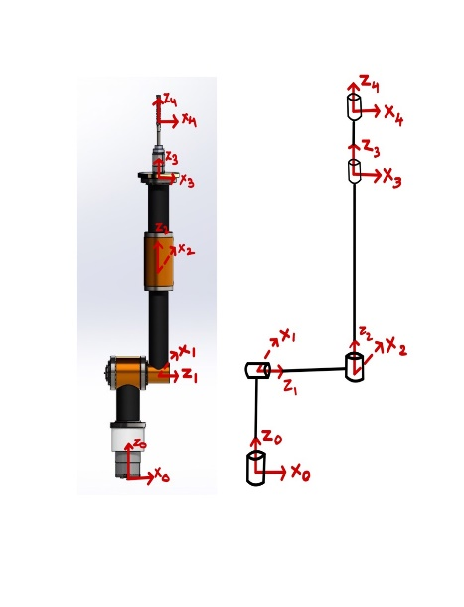
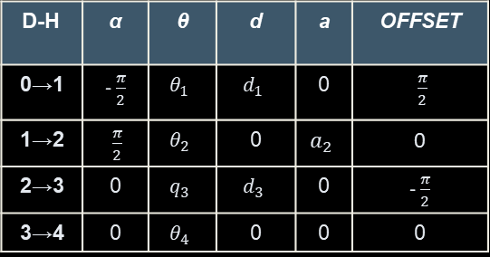
DENAVIT–HARTENBERG TABLE
D-H | α | θ | d | a | OFFSET
0→1 | - $\frac{π}{2}$ | $$θ_{1}$$ | $$d_{1}$$ | 0 | $\frac{π}{2}$
1→2 | $\frac{π}{2}$ | $$θ_{2}$$ | 0 | $$a_{2}$$ | 0
2→3 | 0 | $$q_{3}$$ | $$d_{3}$$ | 0 | - $\frac{π}{2}$
3→4 | 0 | $$θ_{4}$$ | 0 | 0 | 0
The values of
d₁ = 0.222
d₃ = 0.1148
a₂ = 0.6553
Since frame 2→3 has a prismatic joint, the angle is taken as q₃ which is equal to the length moved by the prismatic joint

Slide 7
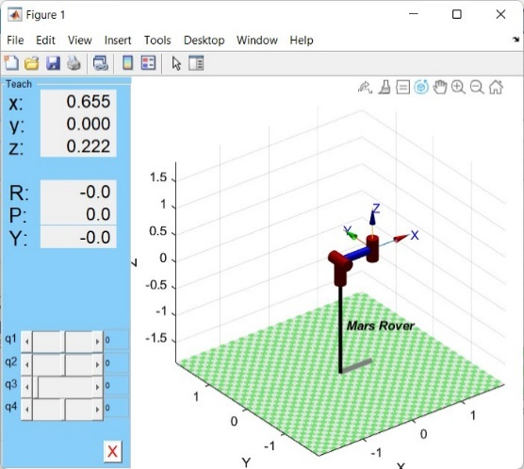
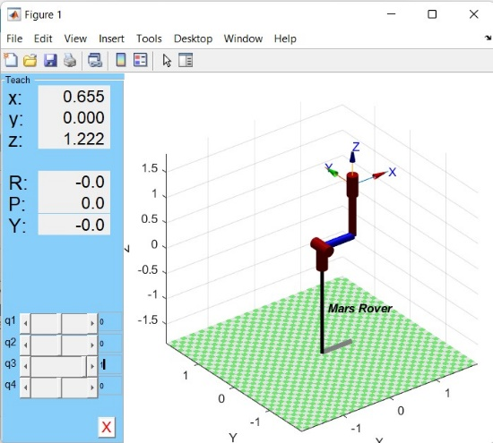
FORWARD KINEMATICS
The Verification of the Forward Kinematics Equation is done by using Peter Corke’s Robotics Toolbox by showing the position values(X,Y,Z) in MATLAB is the same as the translation part of the final Transformation Matrix

Slide 8

INVERSE KINEMATICS
$$θ_{2}=±\cos^{−1}\left(\frac{P_{x}^{2}+P_{y}^{2}−a_{1}^{2}−a_{2}^{2}}{2a_{1}a_{2}}\right)$$
$$θ_{1}=atan2\left(a_{2}S_{2}P_{x}+\left(a_{1}+a_{2}C_{2}\right)P_{y},\left(a_{1}+a_{2}C_{2}\right)P_{x}−a_{2}S_{2}P_{y}\right)$$
$$q_{3}=d_{1}−d_{4}−P_{x}q_{3}=d_{1}−d_{4}−P_{x}$$
$$θ_{4}=−atan2\left(N_{y},N_{x}\right)+θ_{1}−θ_{2}$$

Slide 9
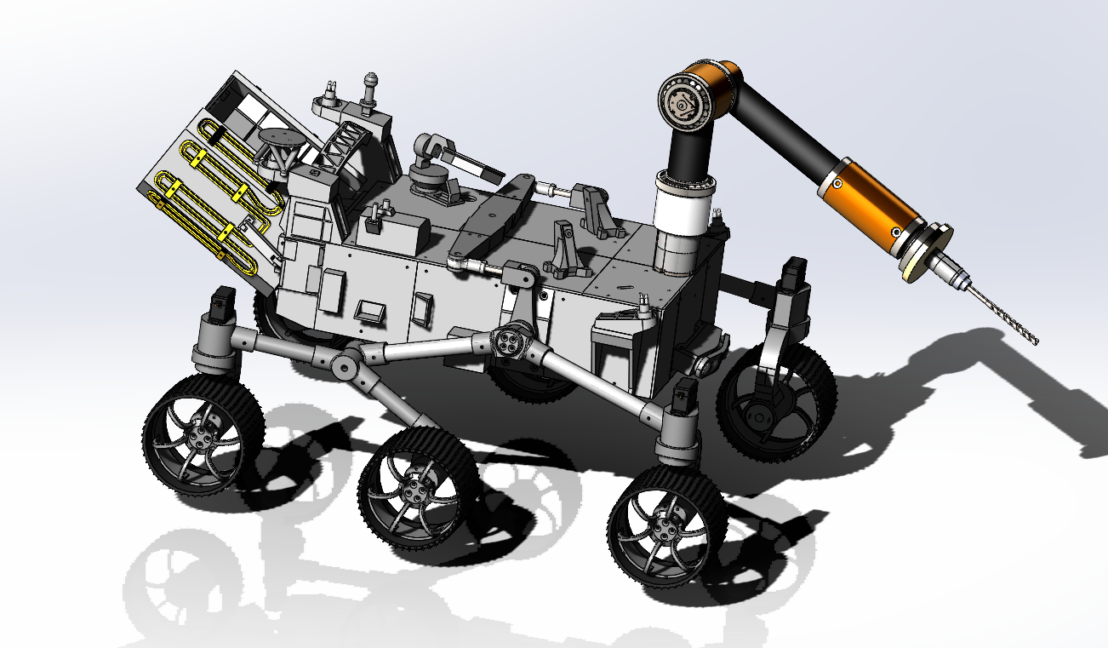
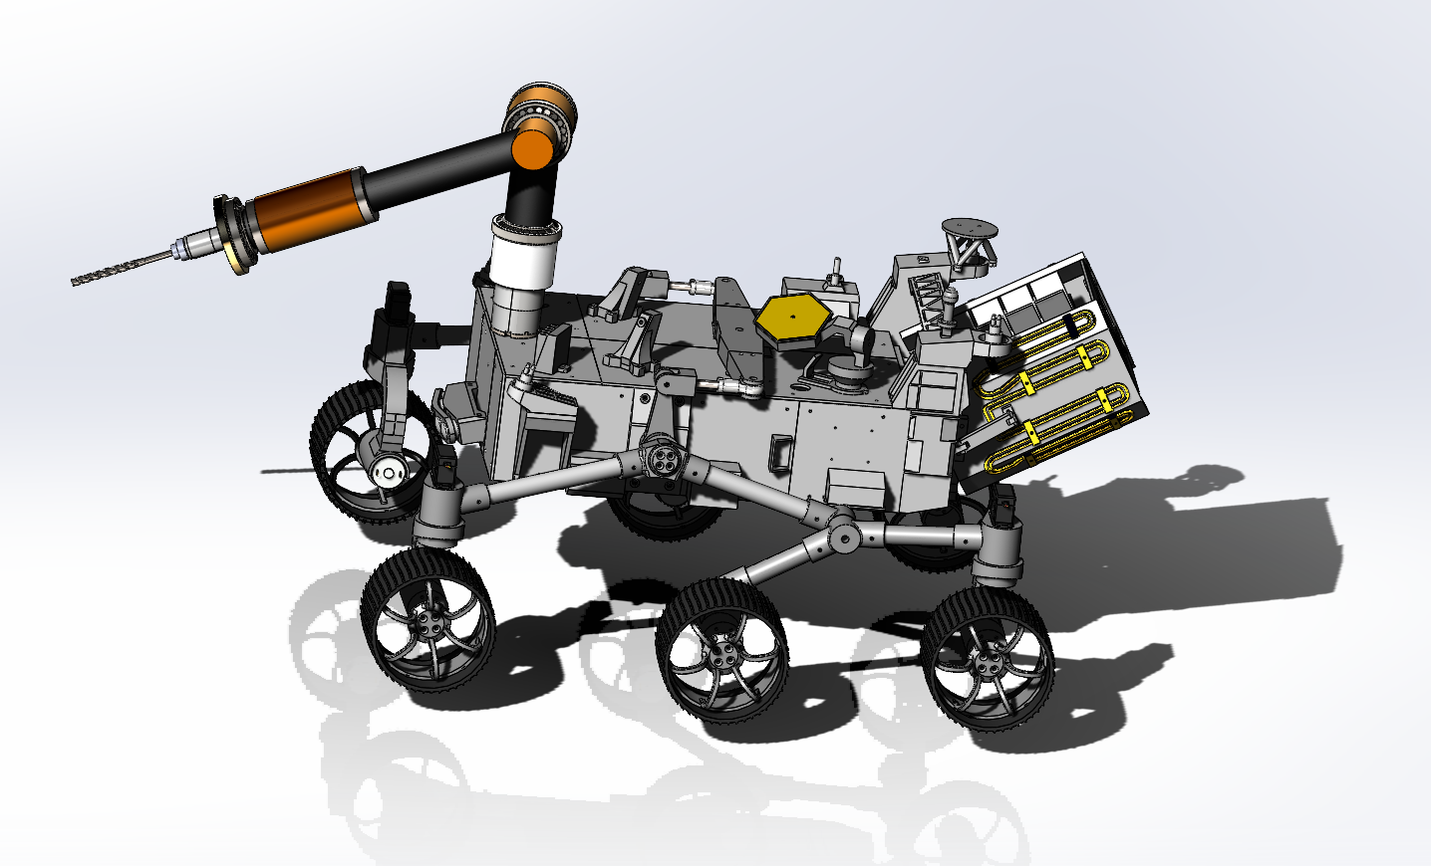
SCREENSHOTS OF CAD MODEL
Left Side View of the Rover
Right Side View of the Rover

Slide 10
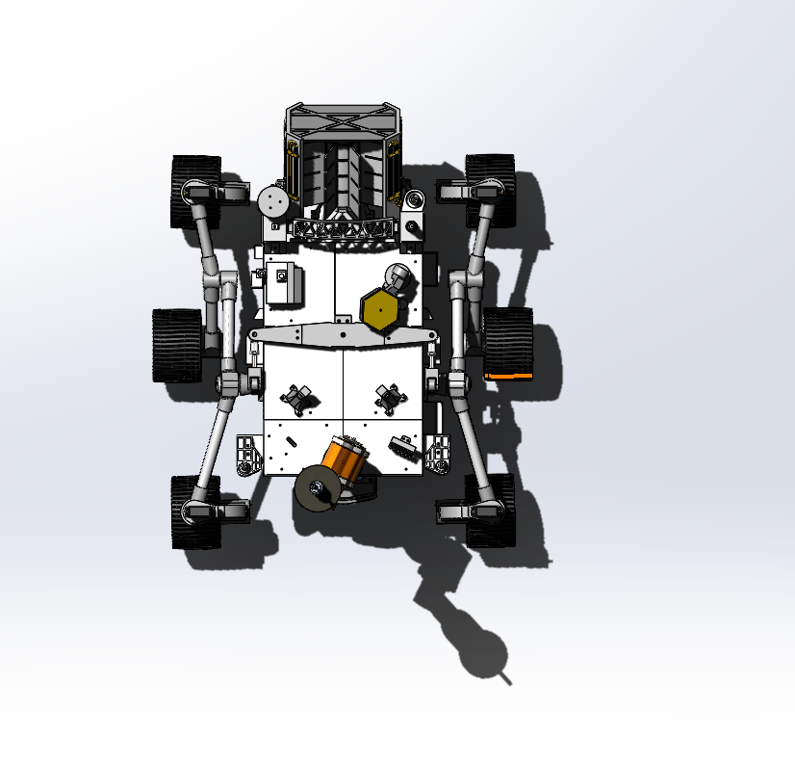
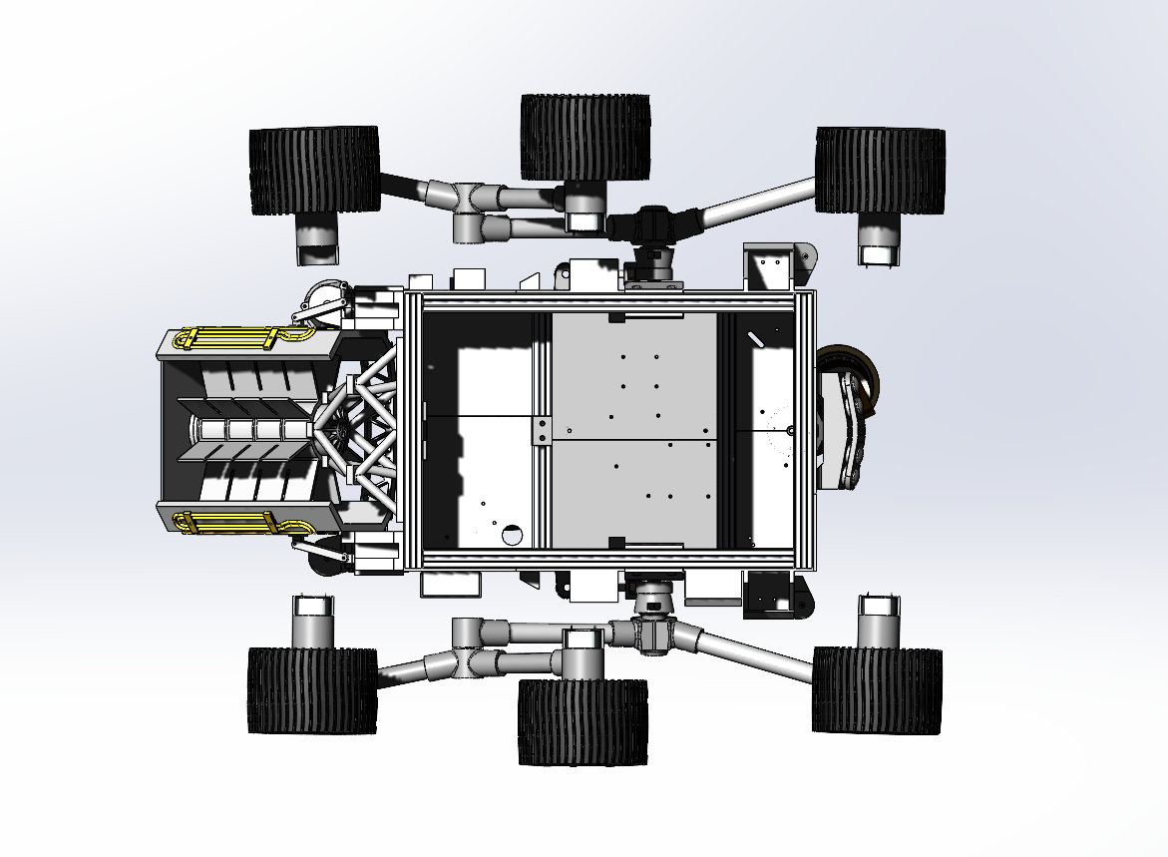
SCREENSHOTS OF CAD MODEL
Bottom View of the Rover
Top View of the Rover

Slide 11
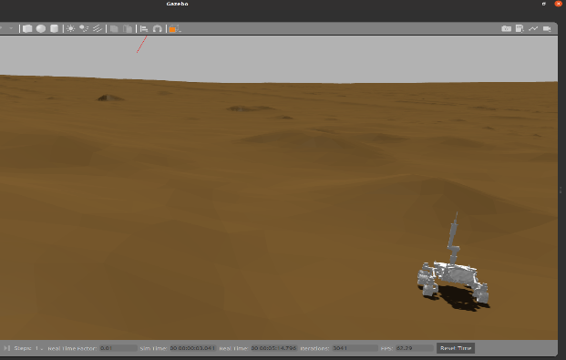
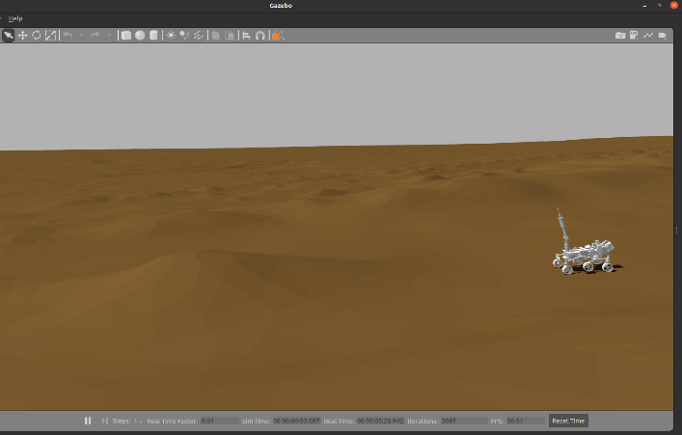
MARS ROVER IN GAZEBO MARTIAN WORLD

Slide 12
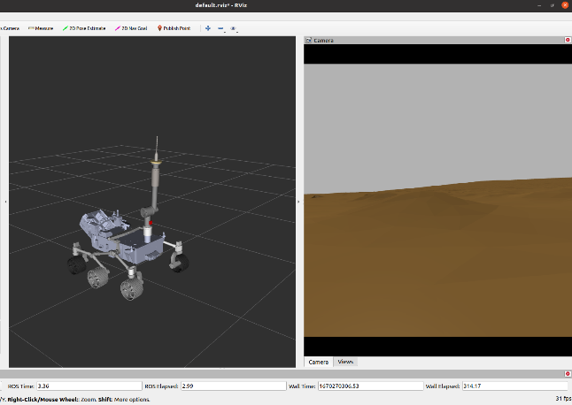
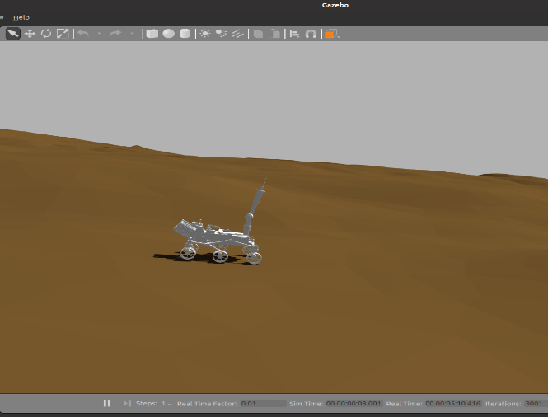
MARS ROVER IN GAZEBO MARTIAN WORLD

Slide 13
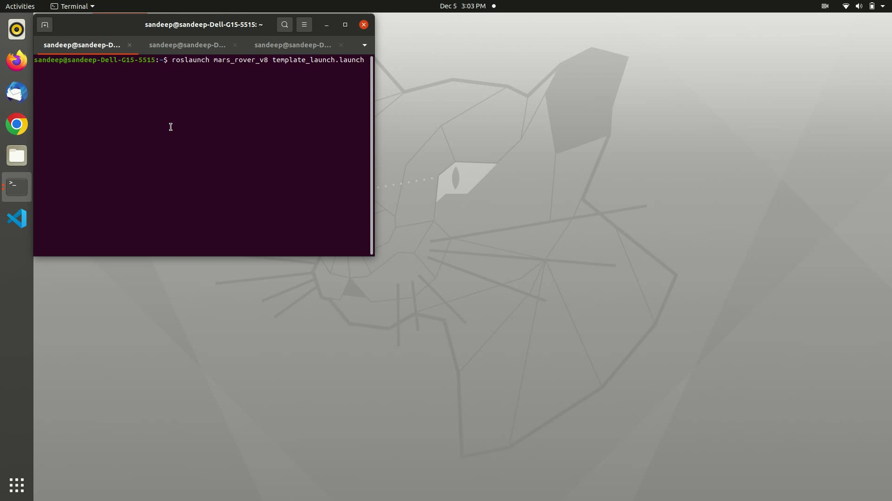
SIMULATION

Slide 14
CHALLENGES FACED
⊚ Multiple iterations of the URDF had to be exported. Earlier versions of the URDF file when spawned in gazebo causing the rover to fall apart.
⊚ The wheels of the rover were vibrating badly when spawned in gazebo. Tuning the PID values using rqt tool of ROS resolved the issue.
⊚ When commanding the joints of the arm to a target point on the surface, we found that it did not touch the point. The arm had to be relocated closer to the edge of the rover’s body.
⊚ Choosing appropriate controllers for moving the rocker-bogie mechanism of the rover.

Slide 15
RESULTS
⊚ We were able to successfully determine the DH table of the rover.
⊚ This allowed for the Homogenous Transformation Matrices to be calculated and the overall transformation matrix of the end effector w.r.t to the base of the arm to be found.
⊚ Similarly, the inverse and forward kinematics was calculated using the Transformation matrices.
⊚ The calculated and the model kinematics were verified using Peter Corke’s Robotics toolbox.
⊚ The task of drilling a hole into a Martian surface was successfully executed and simulated in Gazebo, validating the final functionality of the rover.

Slide 16
CONCLUSION
⊚ The study of a rover in virtual environment was done. A control mechanism was designed and implemented which was successfully implemented in a simulation.
⊚ The kinematics of the manipulator of the rover was calculated and verified.
⊚ We were able to meet our fallback goals. However, our ambitions goals were not done.
⊚ This project has been a great aid in understanding the design and control of a rover that has been used for Mars exploration currently.

Slide 17
Contributions
SANDIP
BOTH
JAYASURIYA
Defined joint axes, origin, coordinates and exported it as URDF
Inverse Kinematics Calculation
Added controllers for the rover
Addition of navigation camera sensor to the rover
Simulation of Rover in Gazebo and RViz Visualization
Error Debugging
Assembly of the Rover and Robotic Arm
Forward Kinematics Calculation
PID Tuning for the controllers
Python script for moving the rover and the arm

Slide 18
References
Rover Model - https://github.com/marsiitr/Mars-Rover
Rover Arm-https://github.com/fath25/AachenRover
Gazebo Environment -https://bitbucket.org/theconstructcore/curiosity_mars_rover/src/master/
Fendall, Myron & Denkins, Pamela & Fisher, Stephen & Oluseyi, Hakeem & Yarborough, Patrice. (2014). Human Mars Exploration Research Objectives.
https://www.researchgate.net/publication/259740528_Human_Mars_Exploration_Research_ Objectives

